Slide 1


Slide 2
What is HTML?

Slide 3
HyperText Markup Language

Slide 4
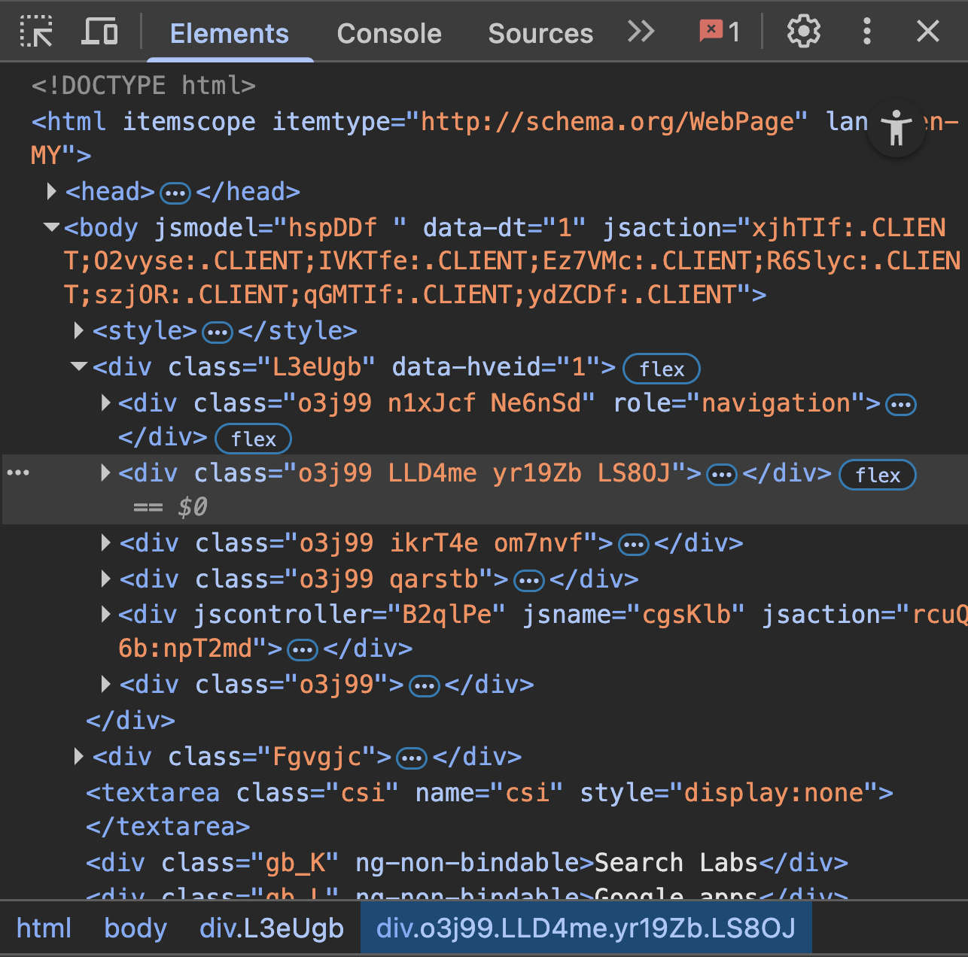
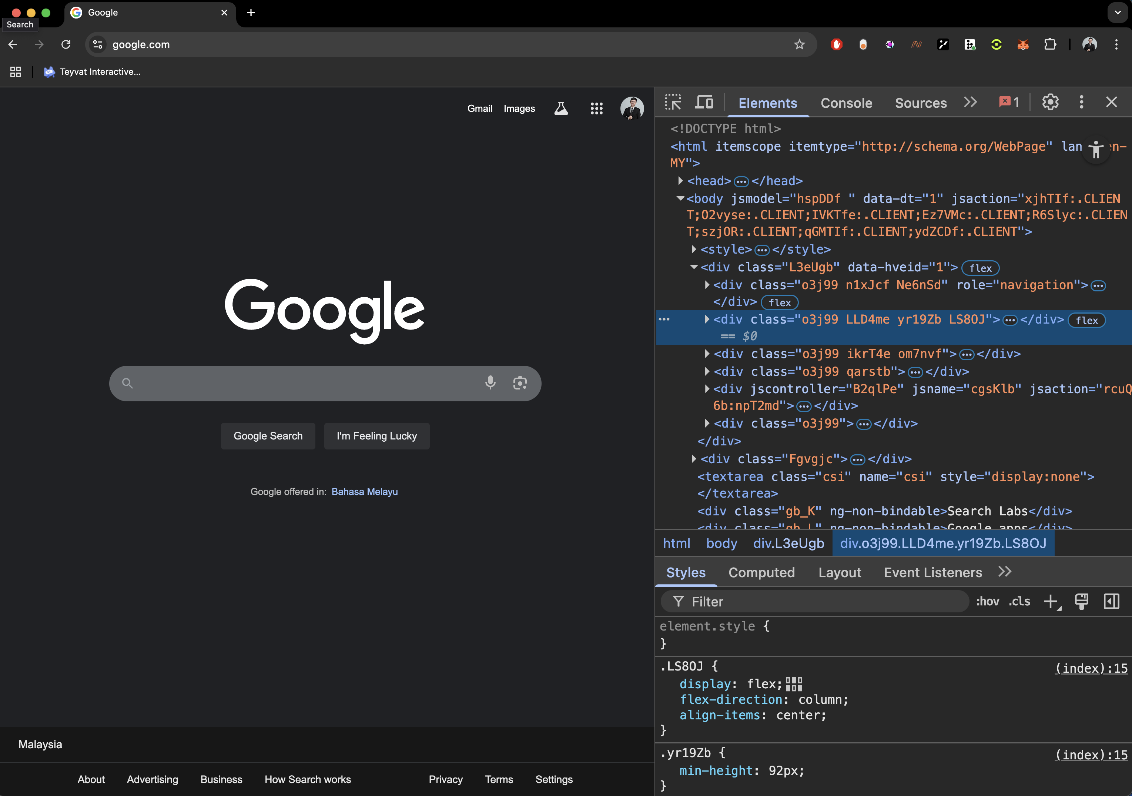

Slide 5
Basically…
It tells your Web Browser what
to render +
how to render

Slide 6
Exercise Time! Follow along with me
to create your first HTML file

Slide 7
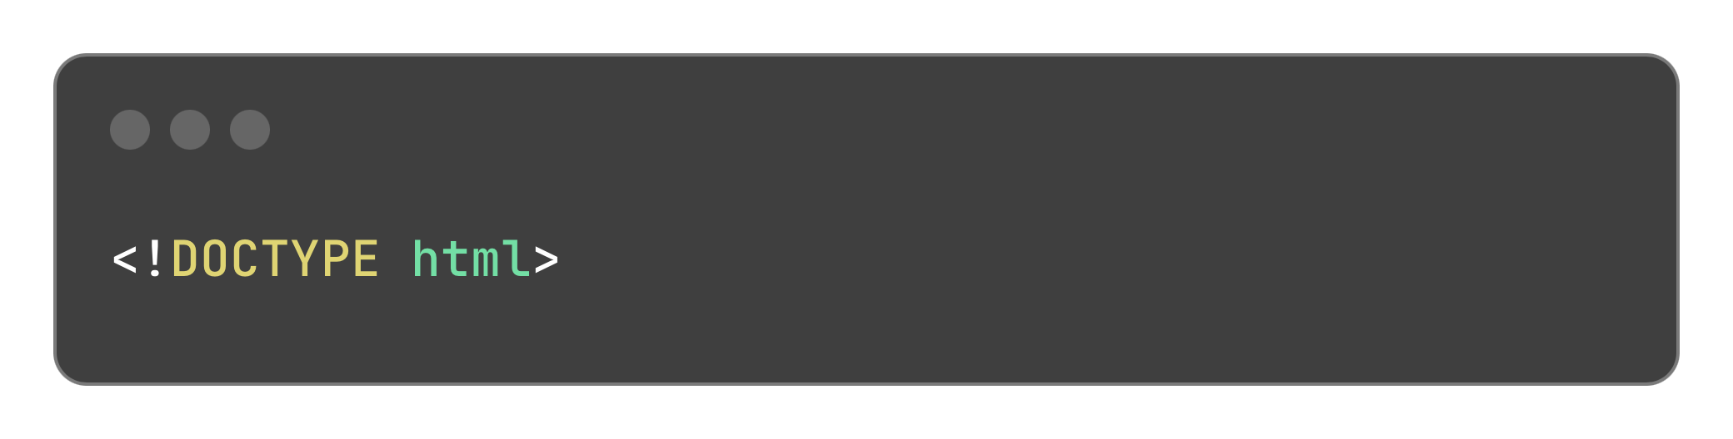
Now that you’ve created your HTML file…
Let’s write some tags to tell your
browser to display something
*This is NOT a html tag
Instead, it tells your browser what to expect from the file

Slide 8
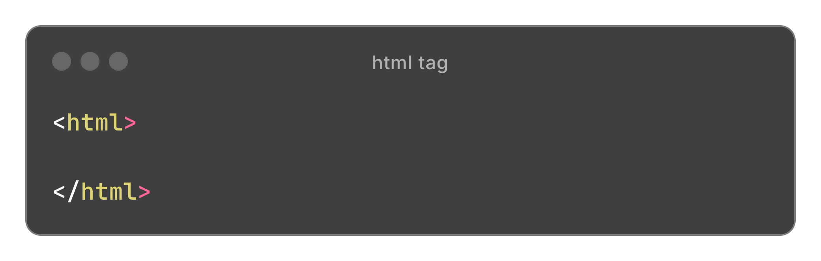
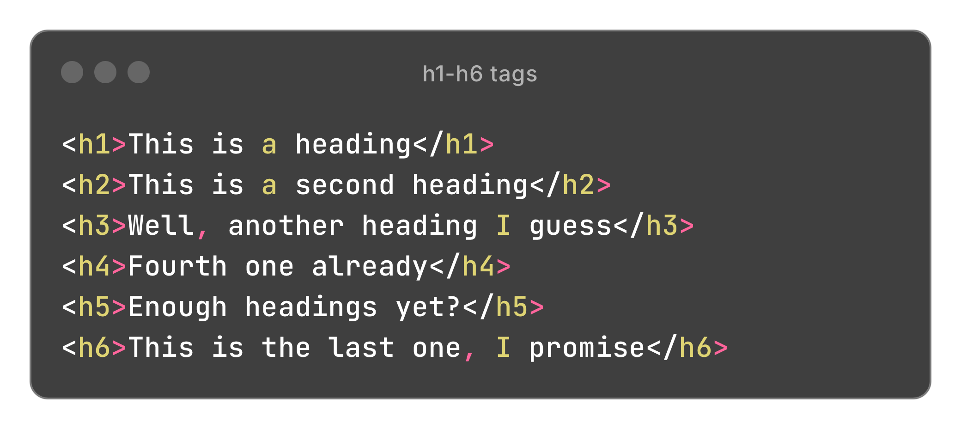
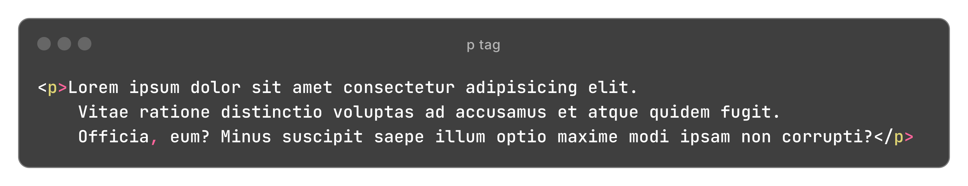
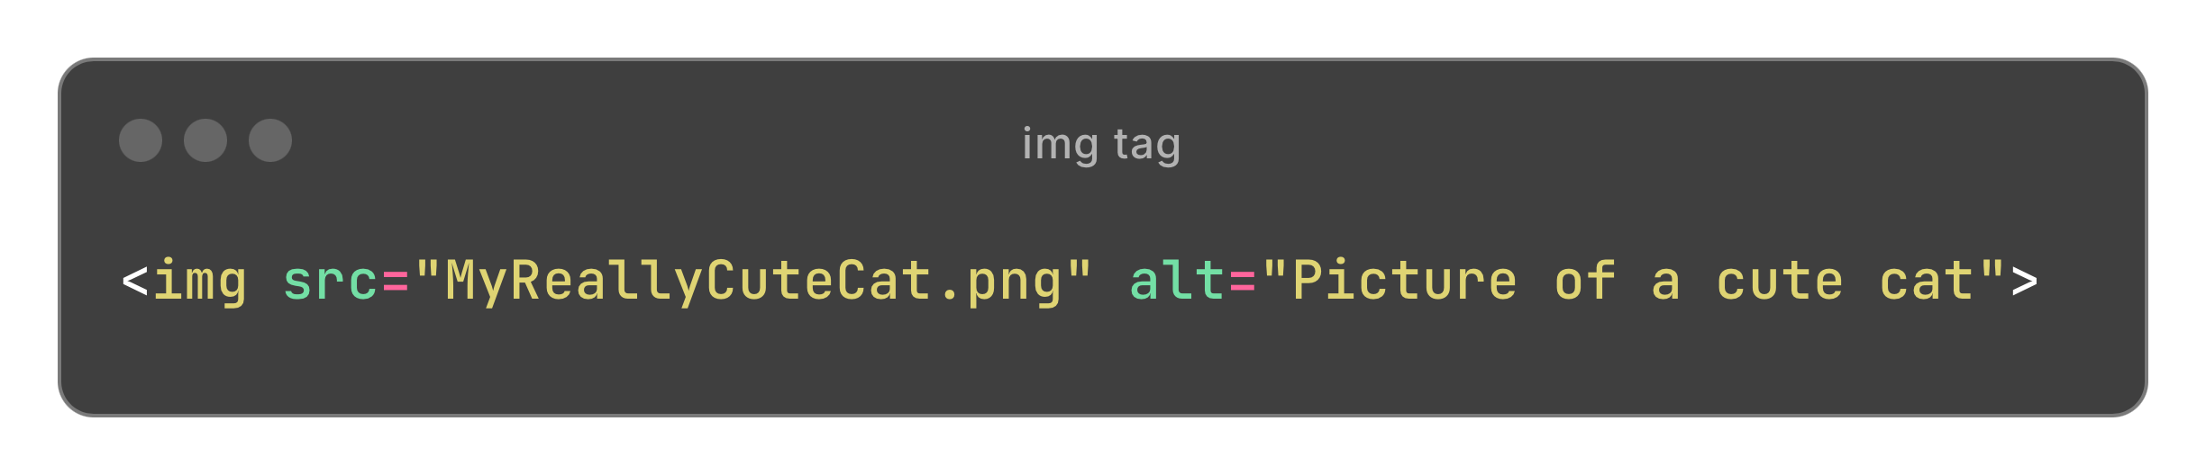
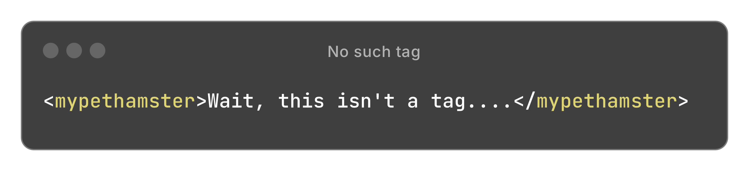
Examples of some tags
html – opening tag
h1-h6 – heading 1 – 6
p – Paragraph
img – Image
mypethamster - ?

Slide 9
Any questions so far?
Well…I might have questions.

Slide 10
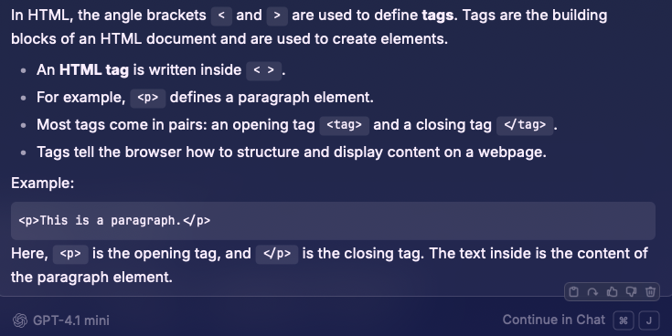
What are <>?
What are they used for?
What’s the difference of <> vs </>
Marks the start of a tag
Marks the end of a tag

Slide 11
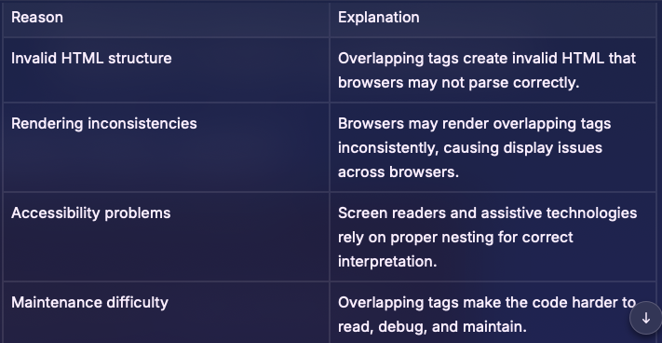
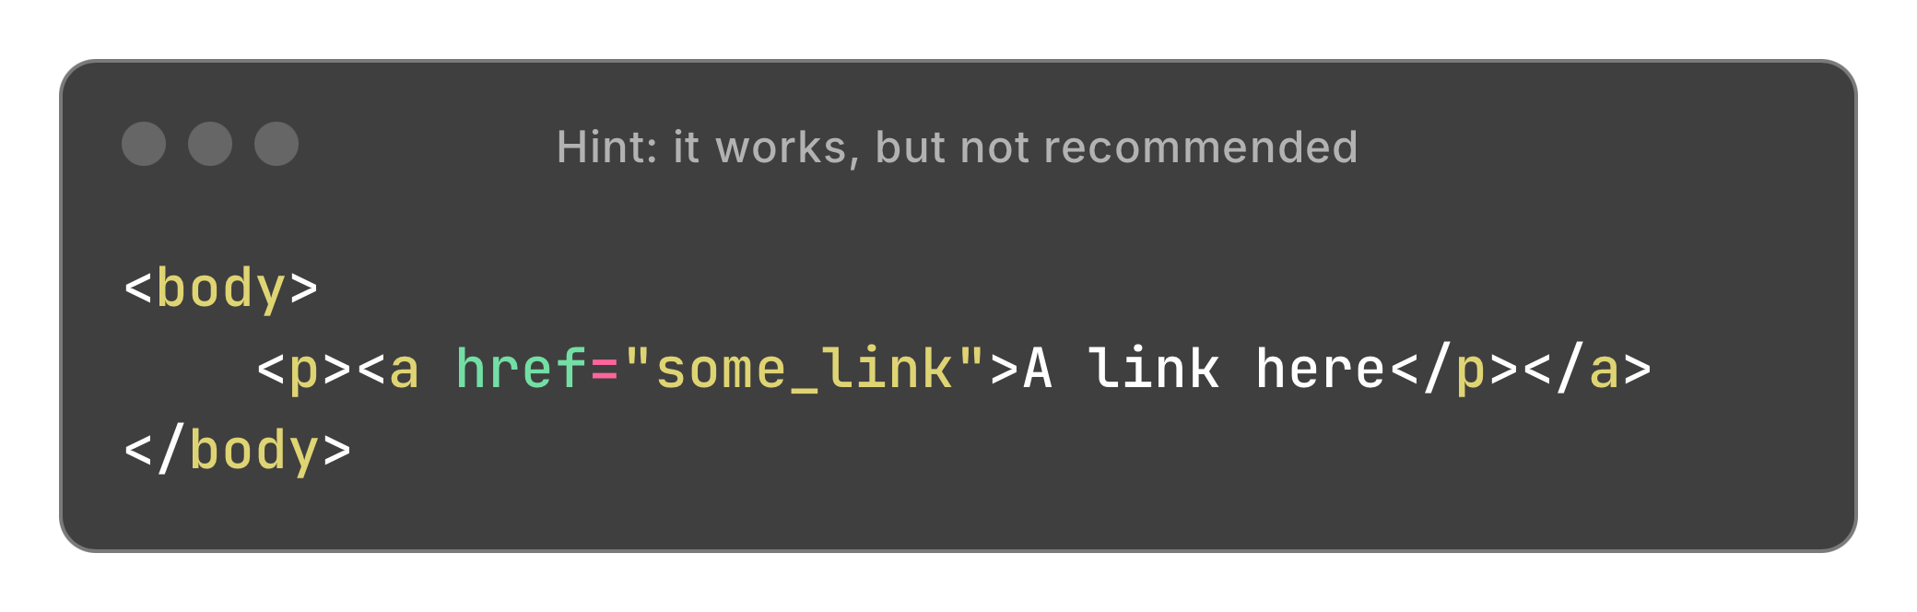
Some more questions!
Does this work?
….but why?

Slide 12
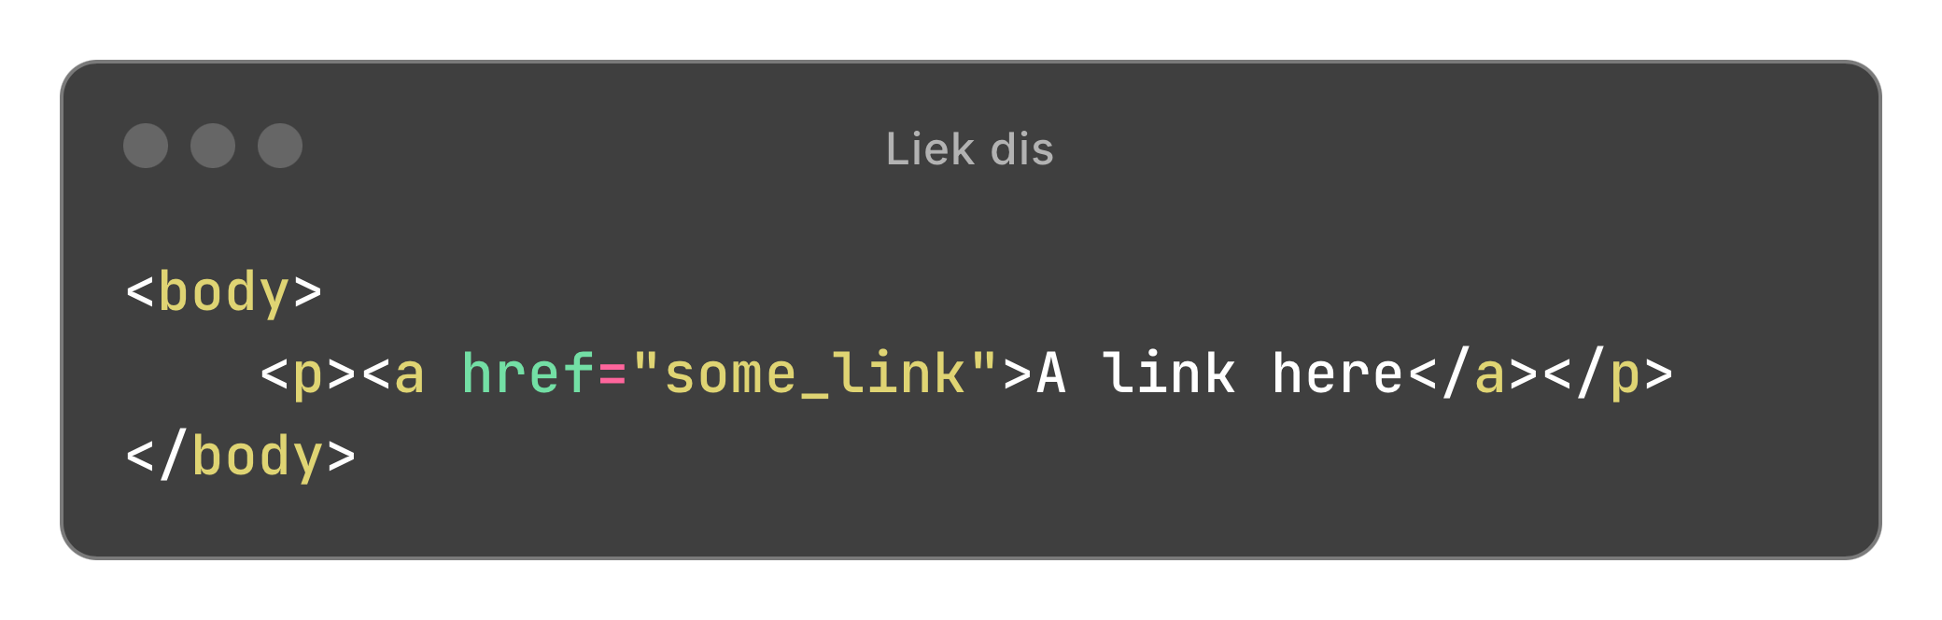
Even more questions!
(Why this guy so many questions?)
So…how are you supposed to combine tags?
It’s →

Slide 13
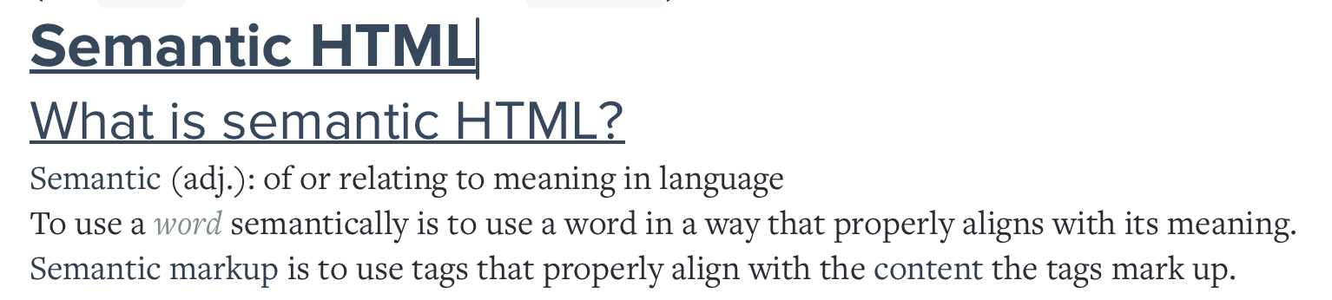
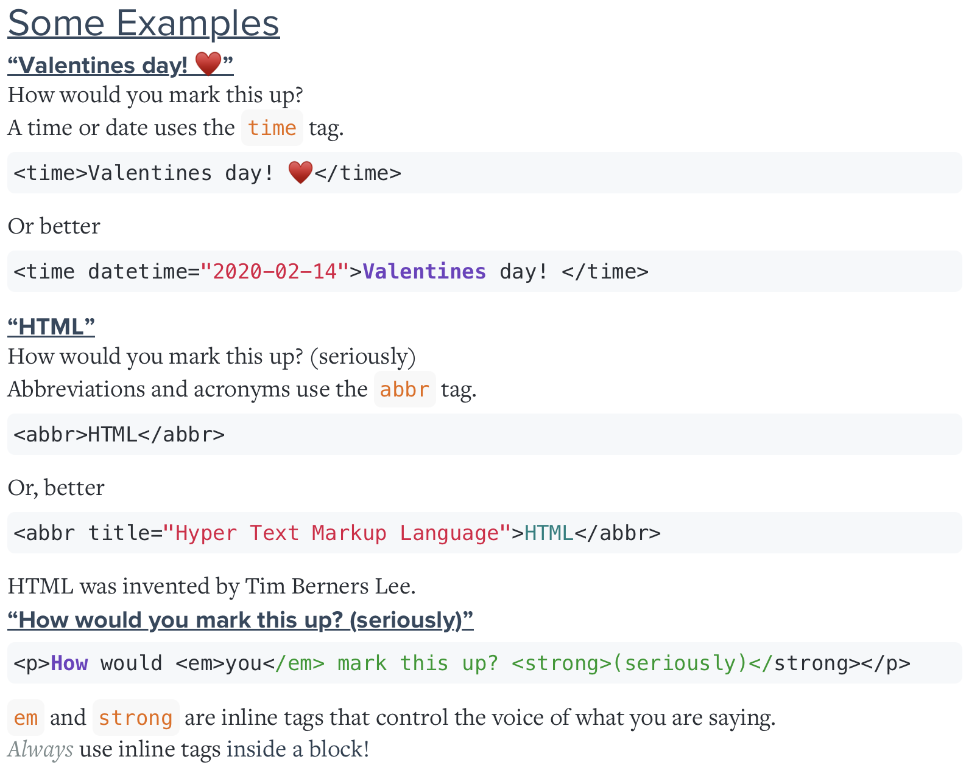
Now for some boring theoretical part….
Notes:
#Show the examples in code

Slide 14
Document Object Model
The DOM is a W3C (World Wide Web Consortium) standard.
The DOM defines a standard for accessing documents:
"The W3C Document Object Model (DOM) is a platform and language-neutral interface that allows programs and scripts to dynamically access and update the content, structure, and style of a document."

Slide 15
Document Object Model
The DOM is a W3C (World Wide Web Consortium) standard.
The DOM defines a standard for accessing documents:
Basically, DOM allows for programs or scripts to update the content however they want
Plus a few things to remember, DOM is a platform and language-neutral interface
That’s it ☺

Slide 16
I lied! (There’s more)
The W3C DOM standard is separated into 3 different parts:
Core DOM - standard model for all document types
XML DOM - standard model for XML documents
HTML DOM - standard model for HTML documents
is
Standard object model and programming interface for HTML.
Defines
The HTML elements as objects*
The properties* of all HTML elements
The methods* to access all HTML elements
The events* for all HTML elements

Slide 17
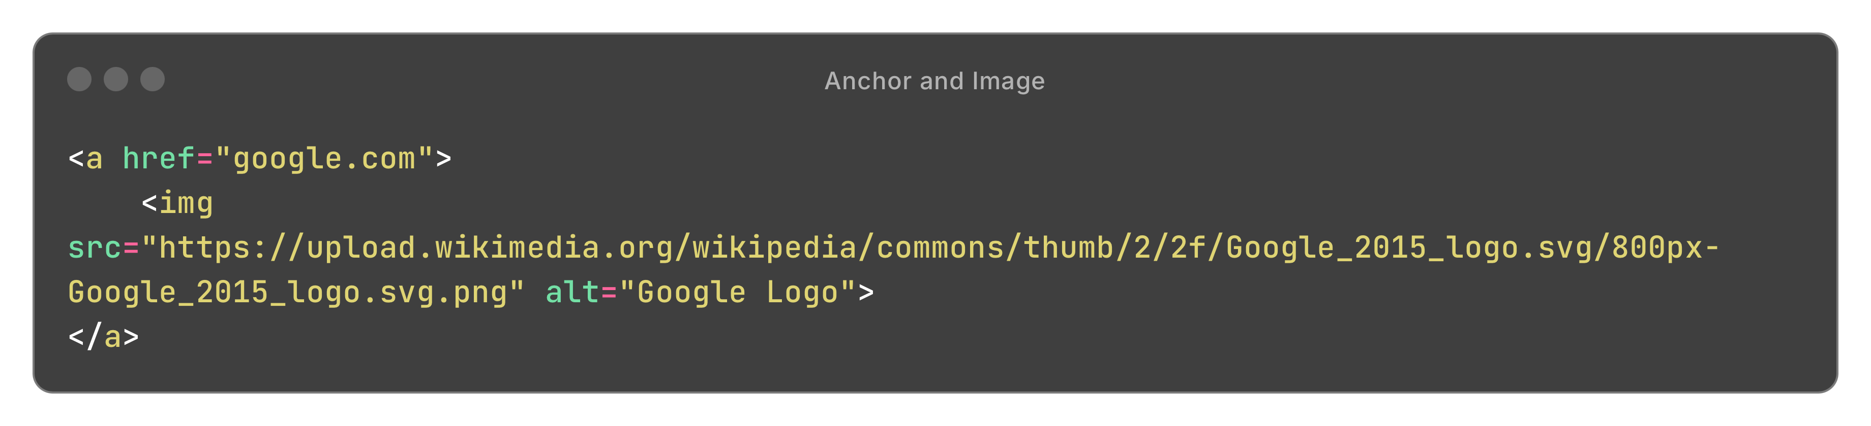
So…you know what a tag is
What about attributes?
<div class=“warning” style=“…”>
From this, you also see that 1 single tag can have multiple attributes
(As many as you’d like)
Let’s do a bit of practice with the <img> tag and <a> tag

Slide 18

There are certain attributes that are predefined and important to certain tags
For example:-
<img> a. src b. alt c. width (optional) d. height (optional)
<a> a. href
<input> a. name b. type c. value d. placeholder (hint)
Let’s try creating these few inputs for yourself

Slide 19
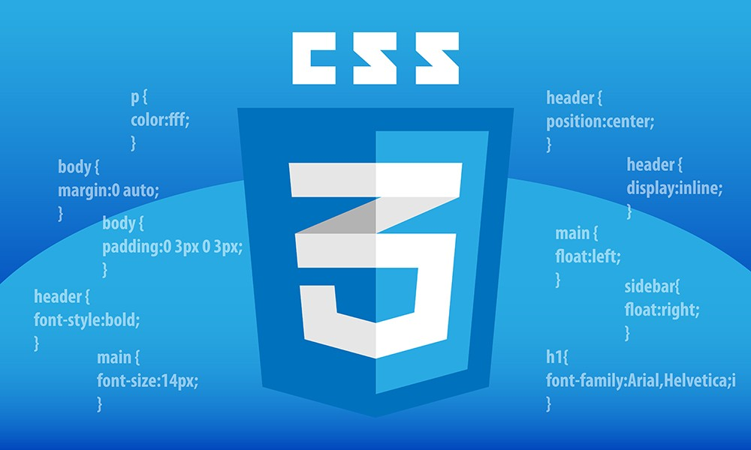
Cascading Style Sheet

Slide 20
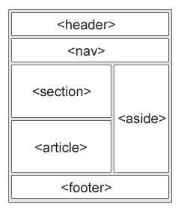
But before that…
Let’s learn about some semantic elements
*One would usually structure
their html file like this.
*Well, you could also choose not to…
*….but why?
*Just do it, please.
*Okay, there’s actually more than one way

Slide 21
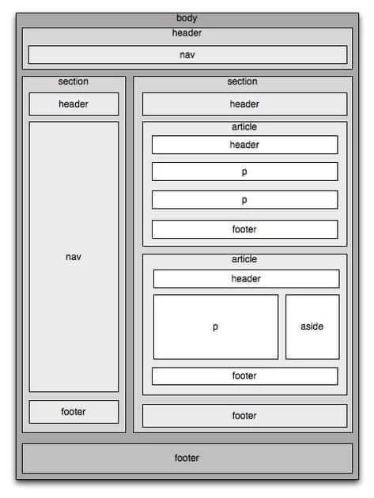
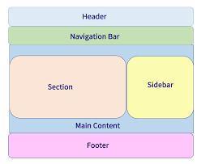
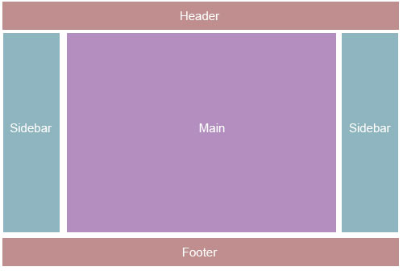
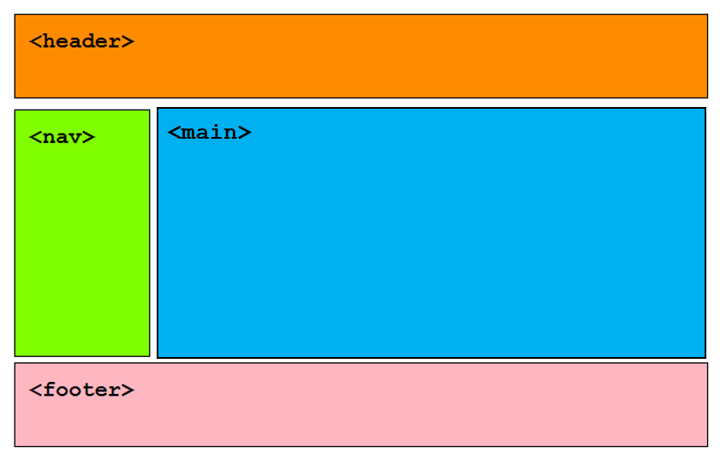
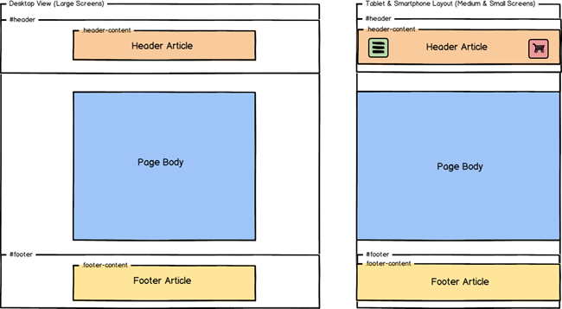
Some other layouts
You get the idea.
Just make sure you follow a generic structure, and use semantic elements to represent them.
Next up: CSS Box model

